Slide 1


Slide 3


Slide 4


Slide 5


Slide 7


Slide 8


Slide 9


Slide 10
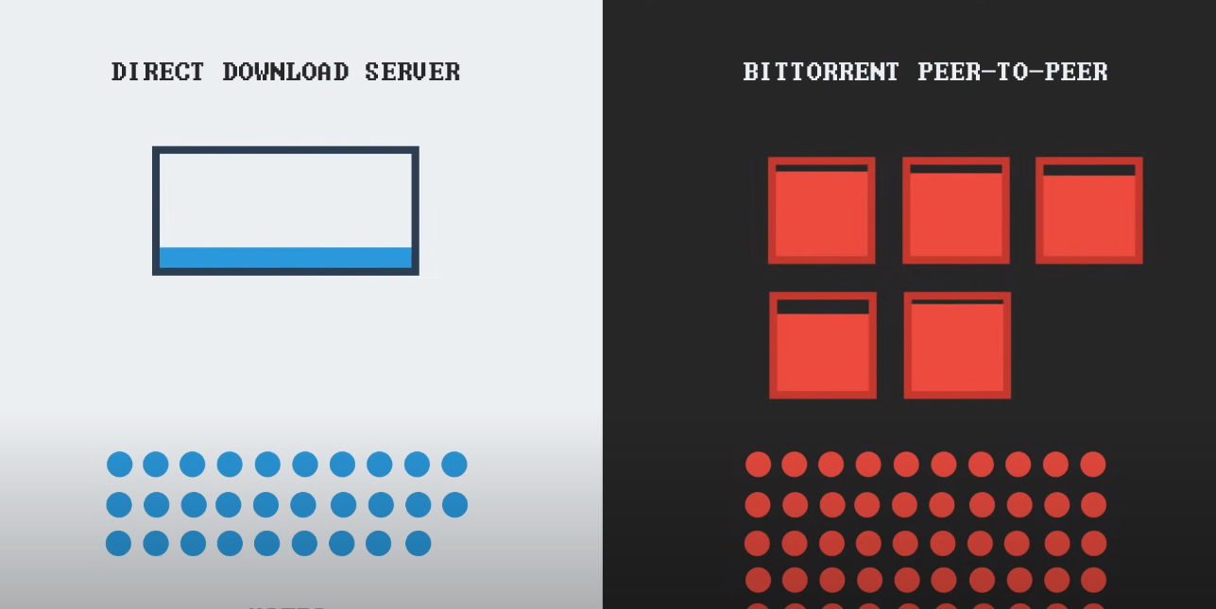

Slide 12
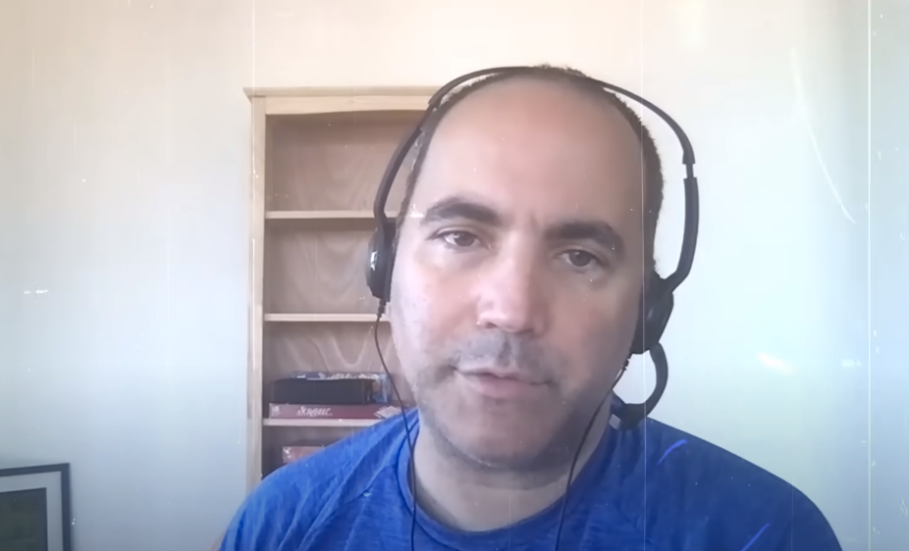
Bram Cohen
Inventer of the Bit-Torrent Protocol, 2001

Slide 13
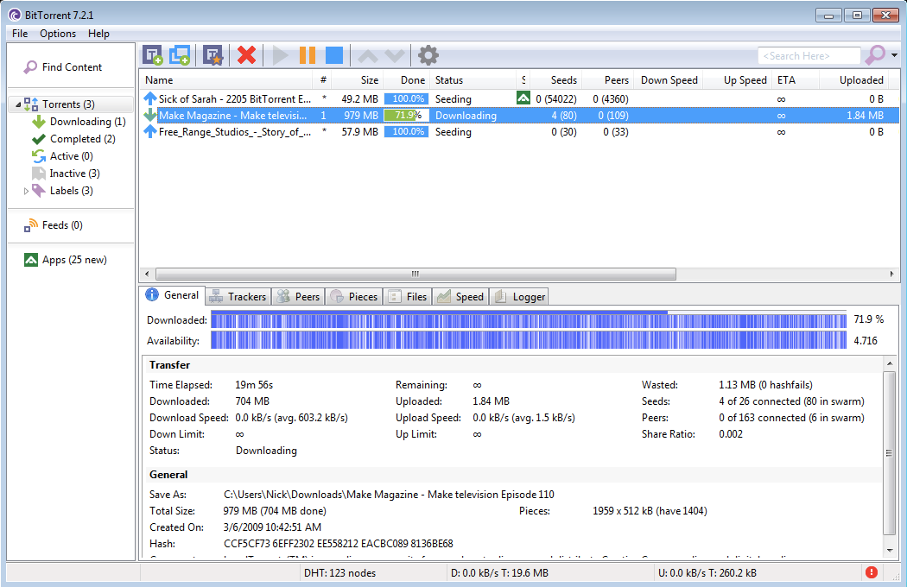

Slide 14
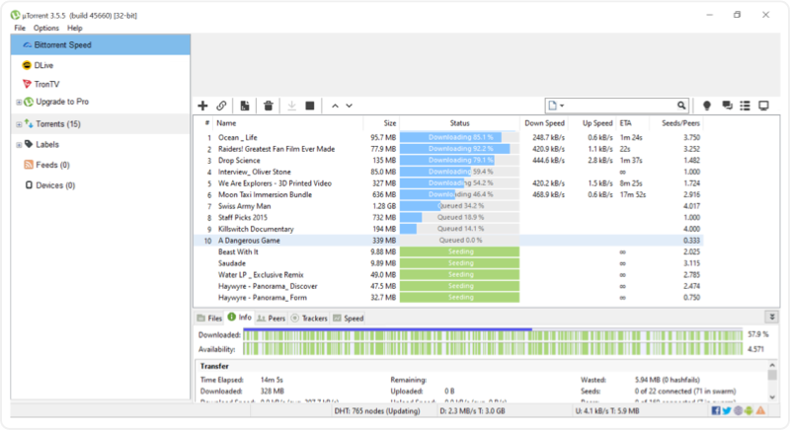

Slide 15
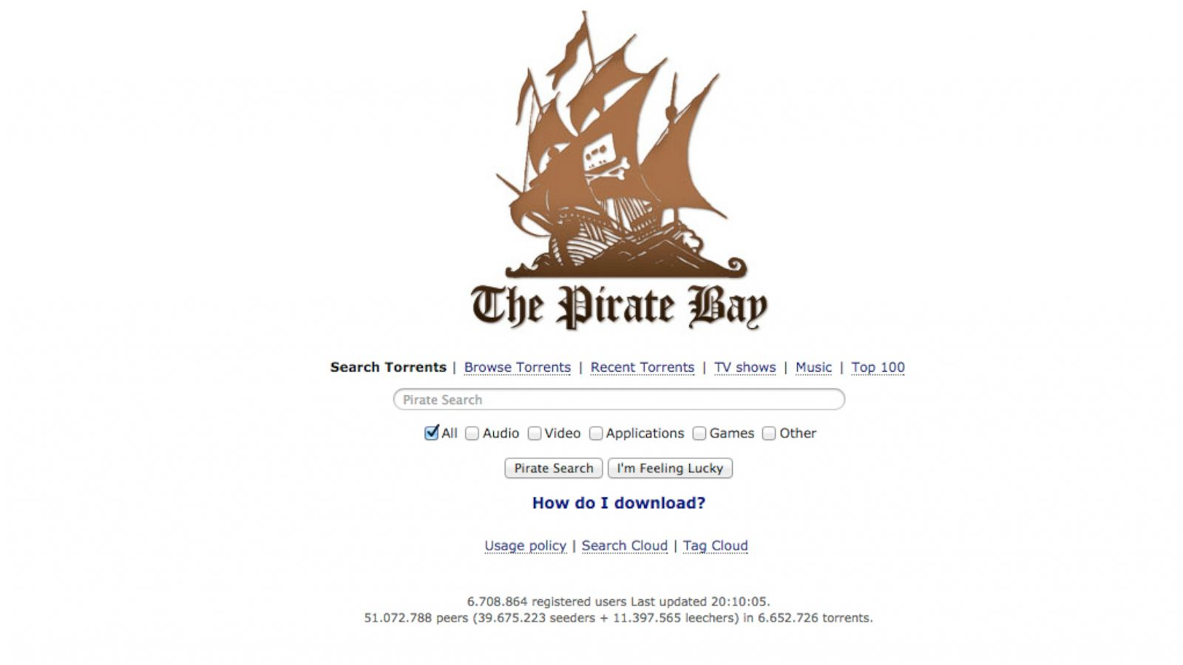

Slide 16


Slide 17
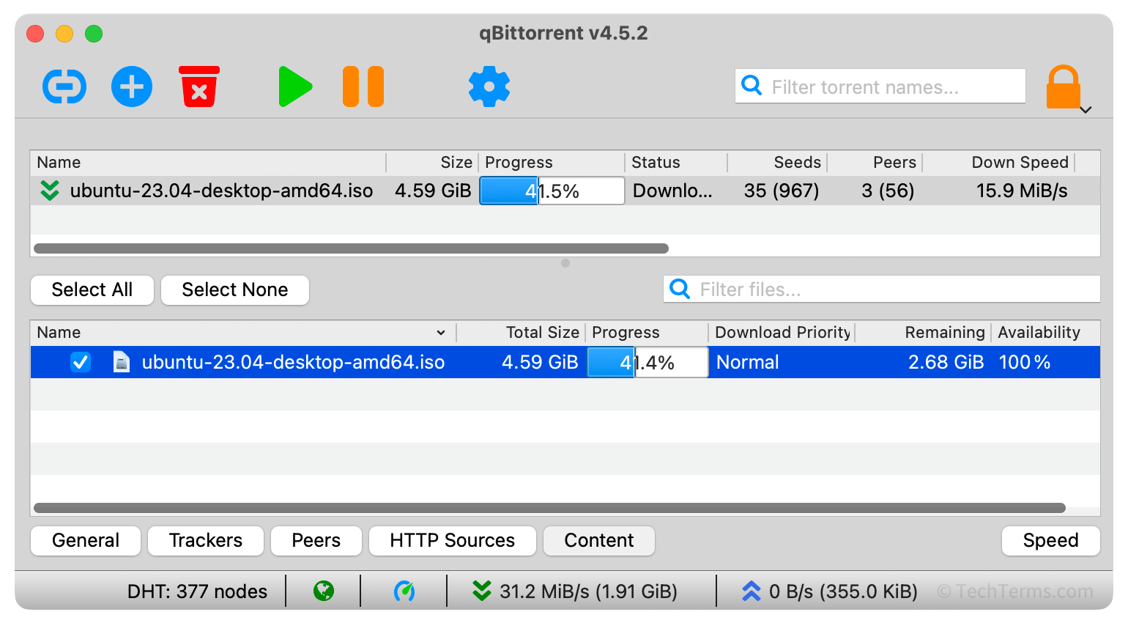

Slide 18


Slide 19


Slide 20
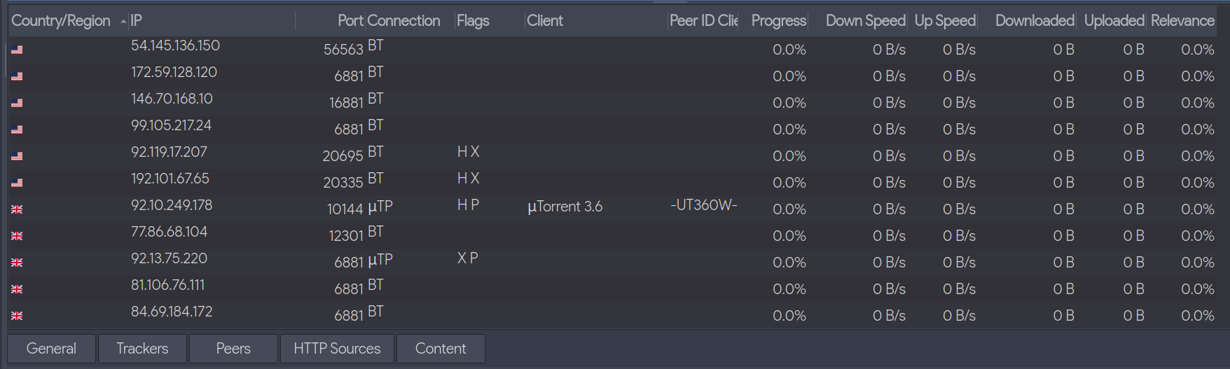

Slide 21


Slide 23


Slide 24
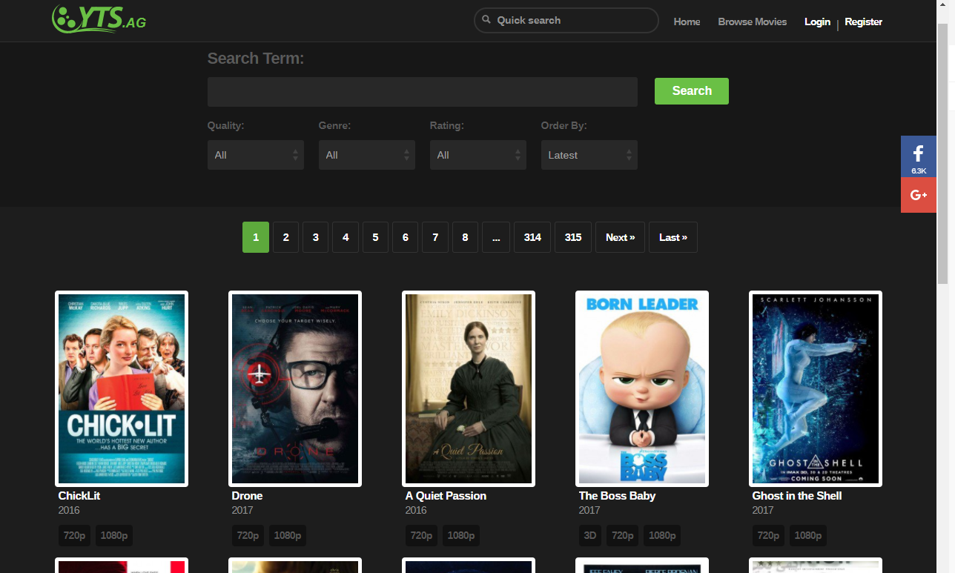

Slide 25


Slide 26
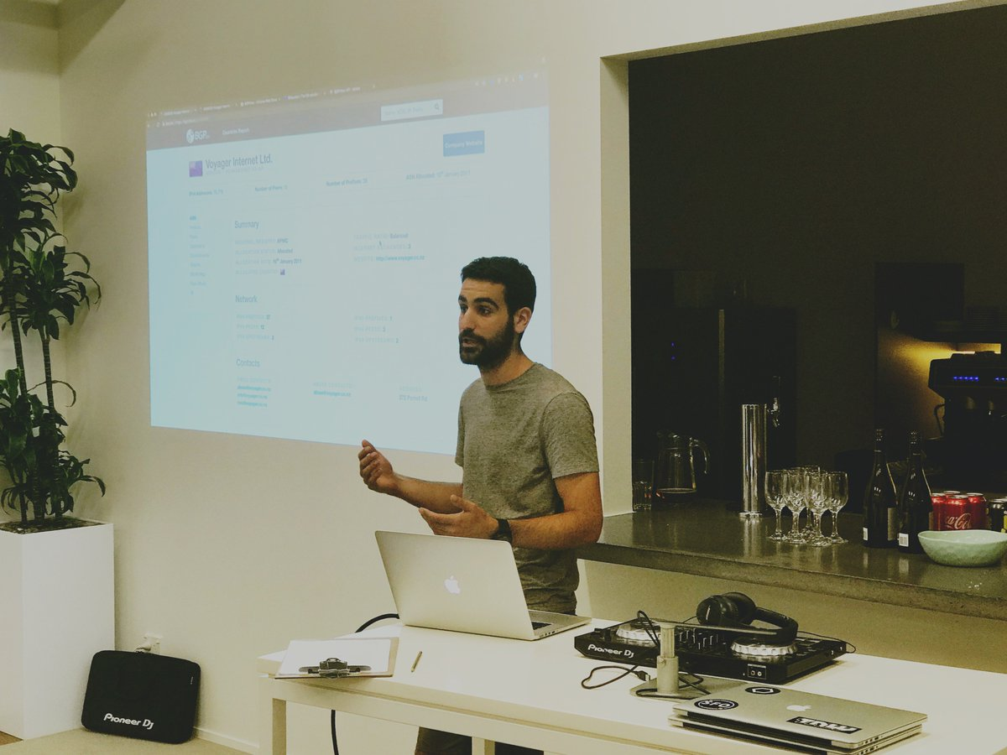

Slide 27

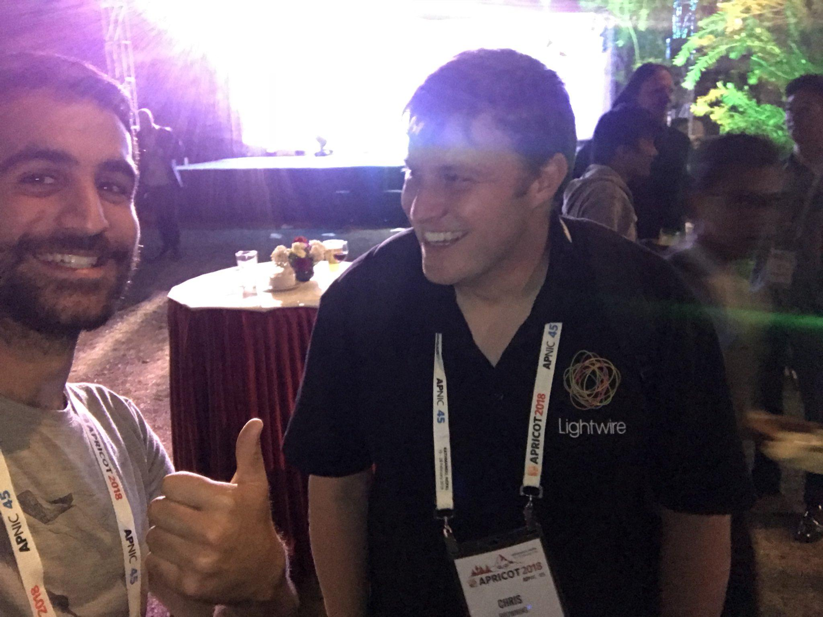

Slide 28
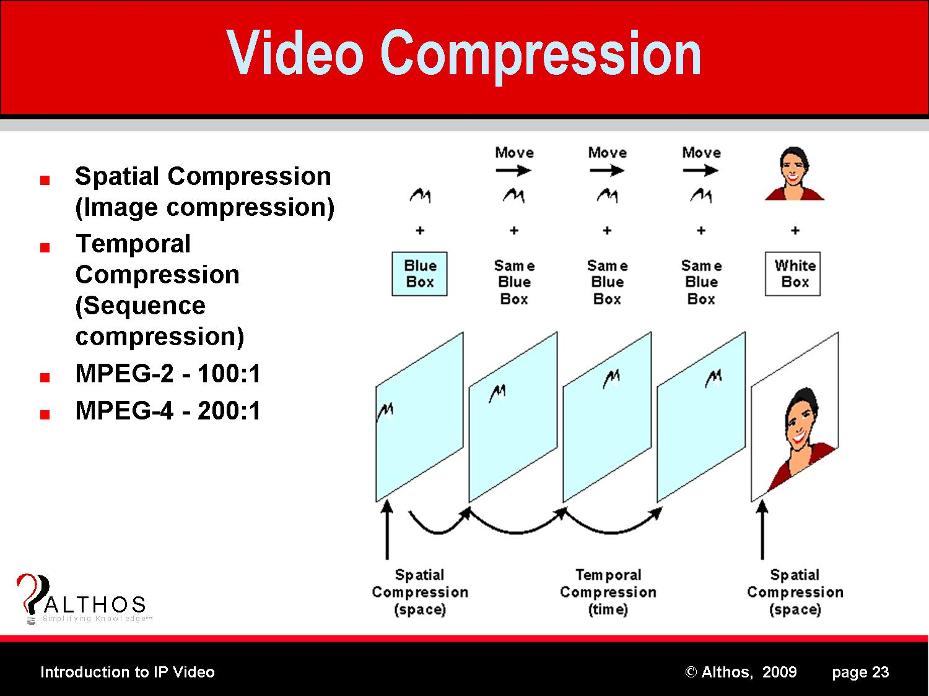

Slide 29


Slide 30
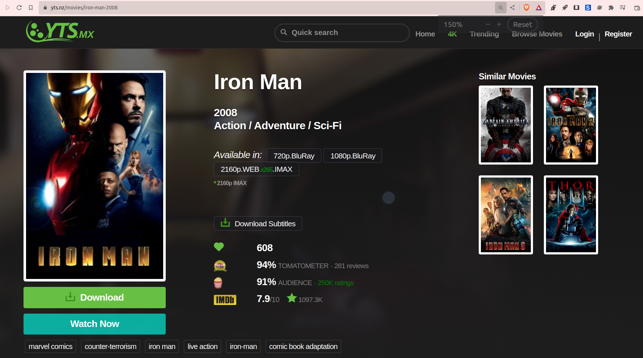

Slide 31
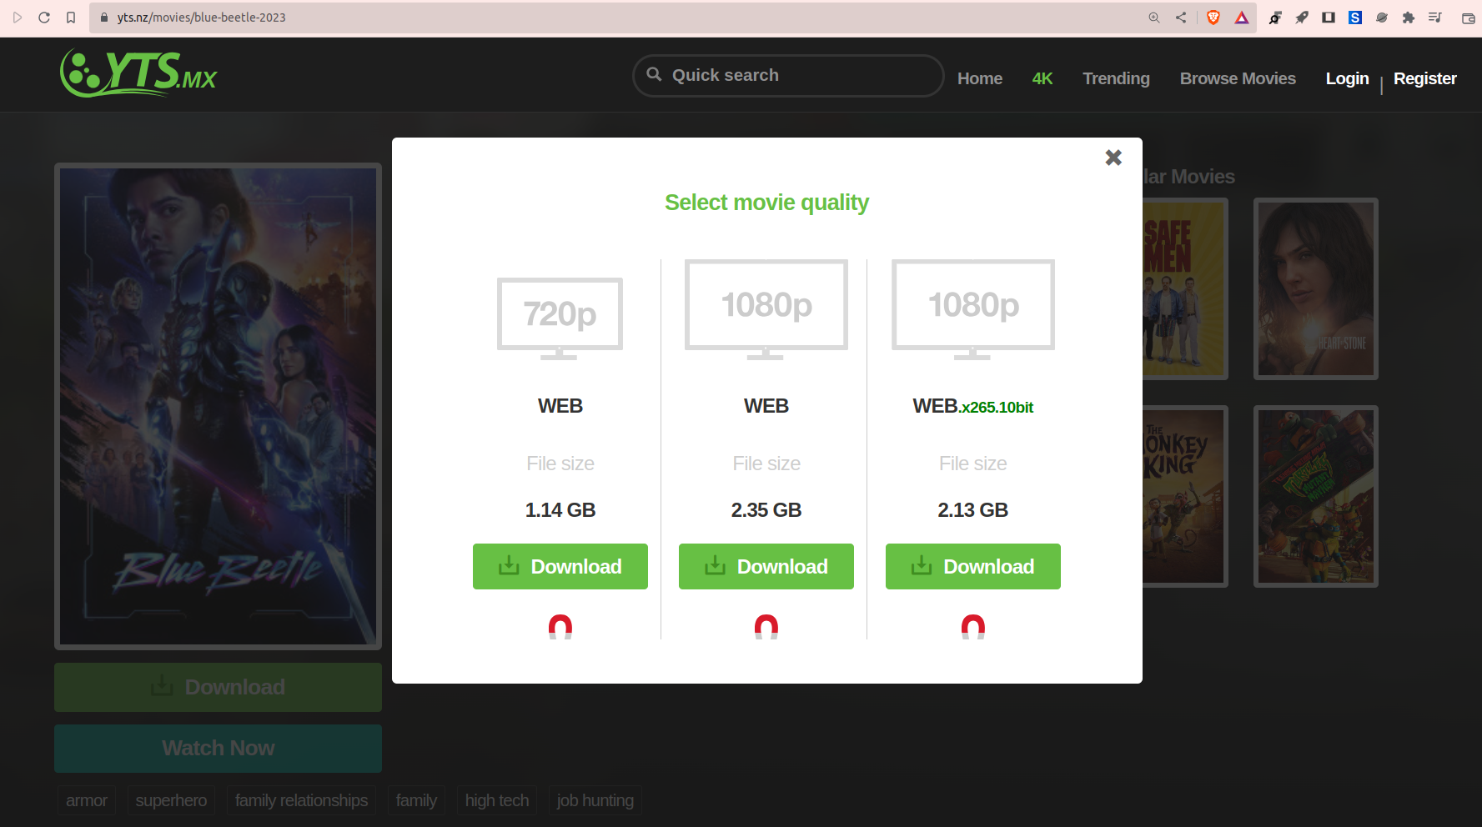

Slide 33


Slide 34
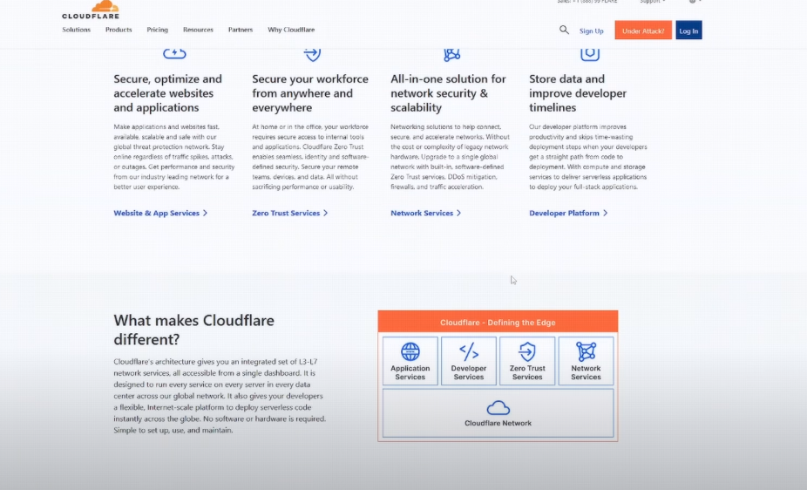

Slide 36
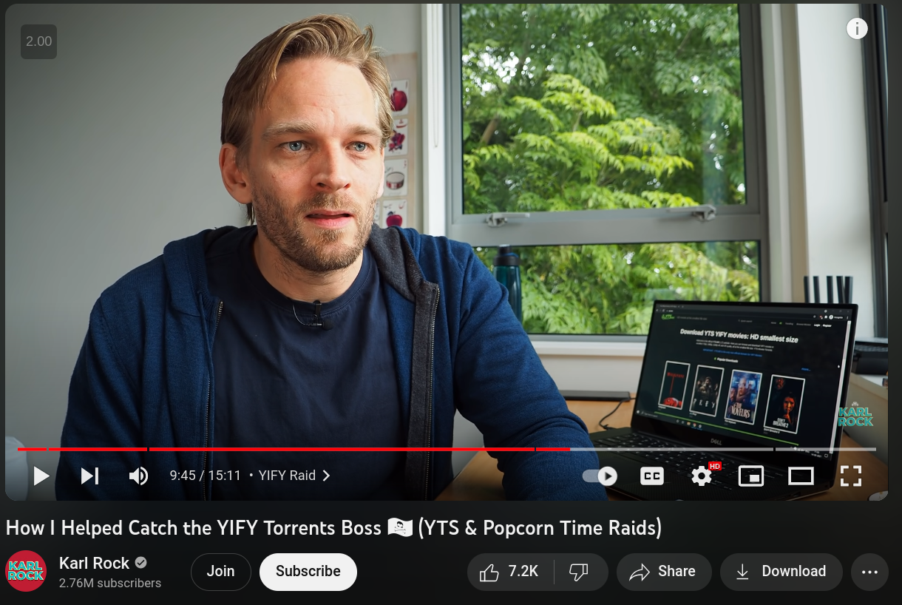

Slide 37


Slide 38
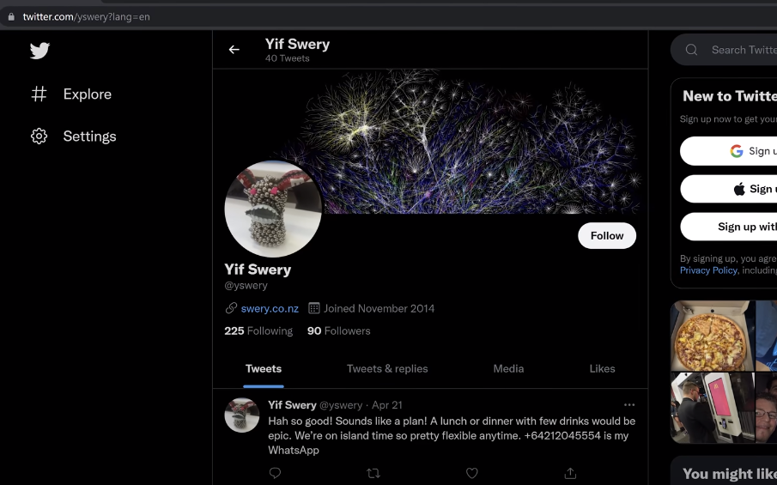

Slide 39

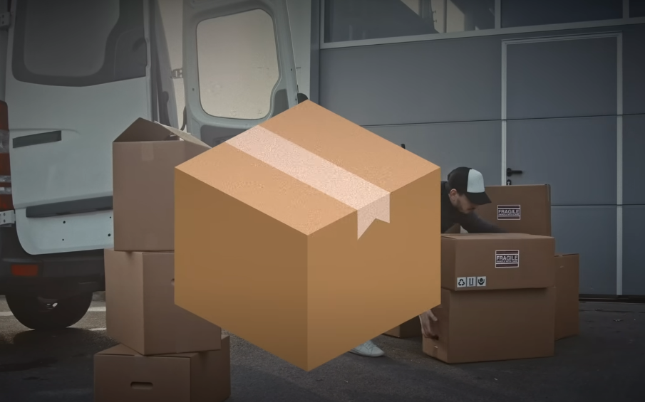

Slide 40



Slide 41


Slide 43
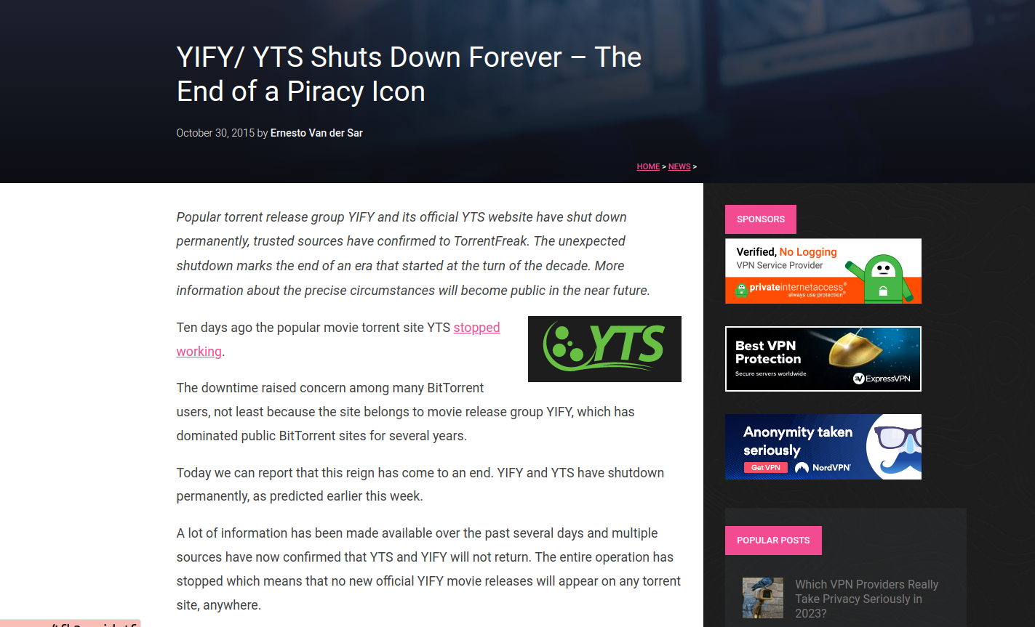

Slide 44
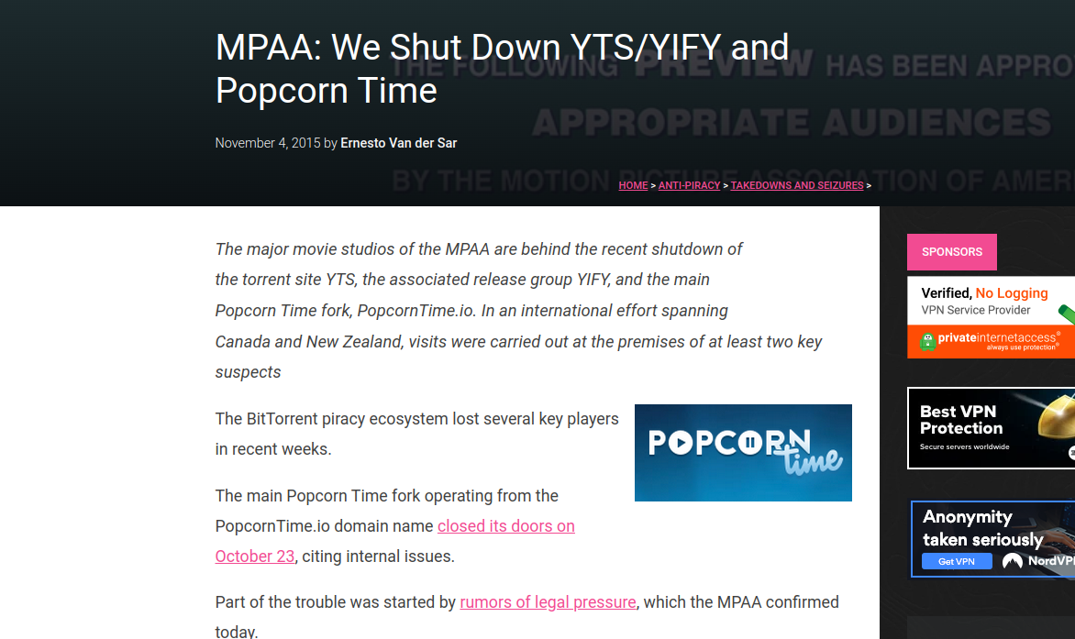

Slide 46
References
https://www.youtube.com/watch?v=KjymSINEEhw&t=9s
https://www.youtube.com/watch?v=A46FZmpL2gk&t=12s
https://torrentfreak.com/mpaa-we-shut-down-ytsyify-and-popcorn-time-151103/

